Slide 1
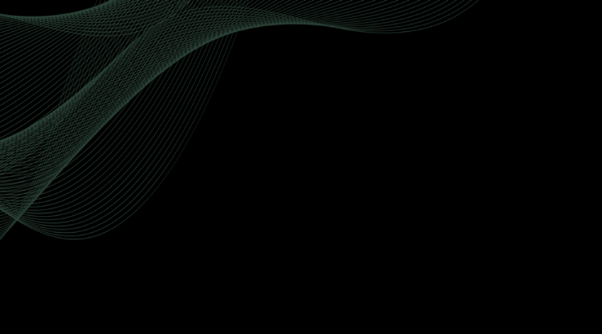
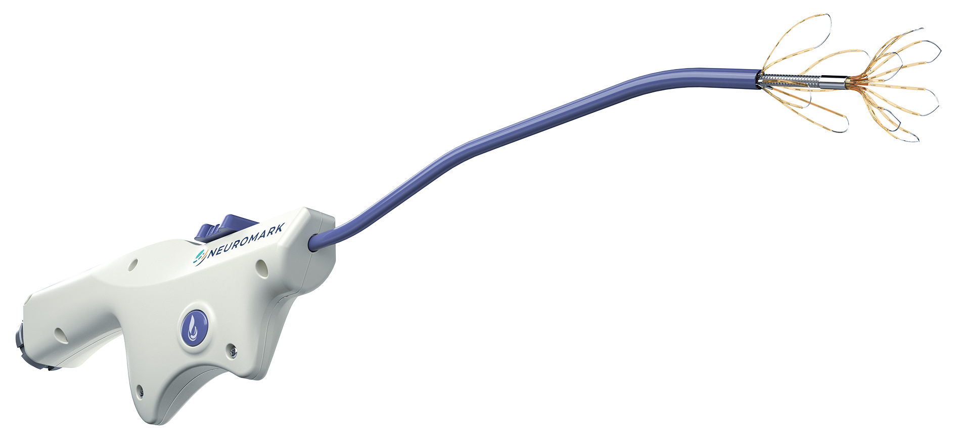
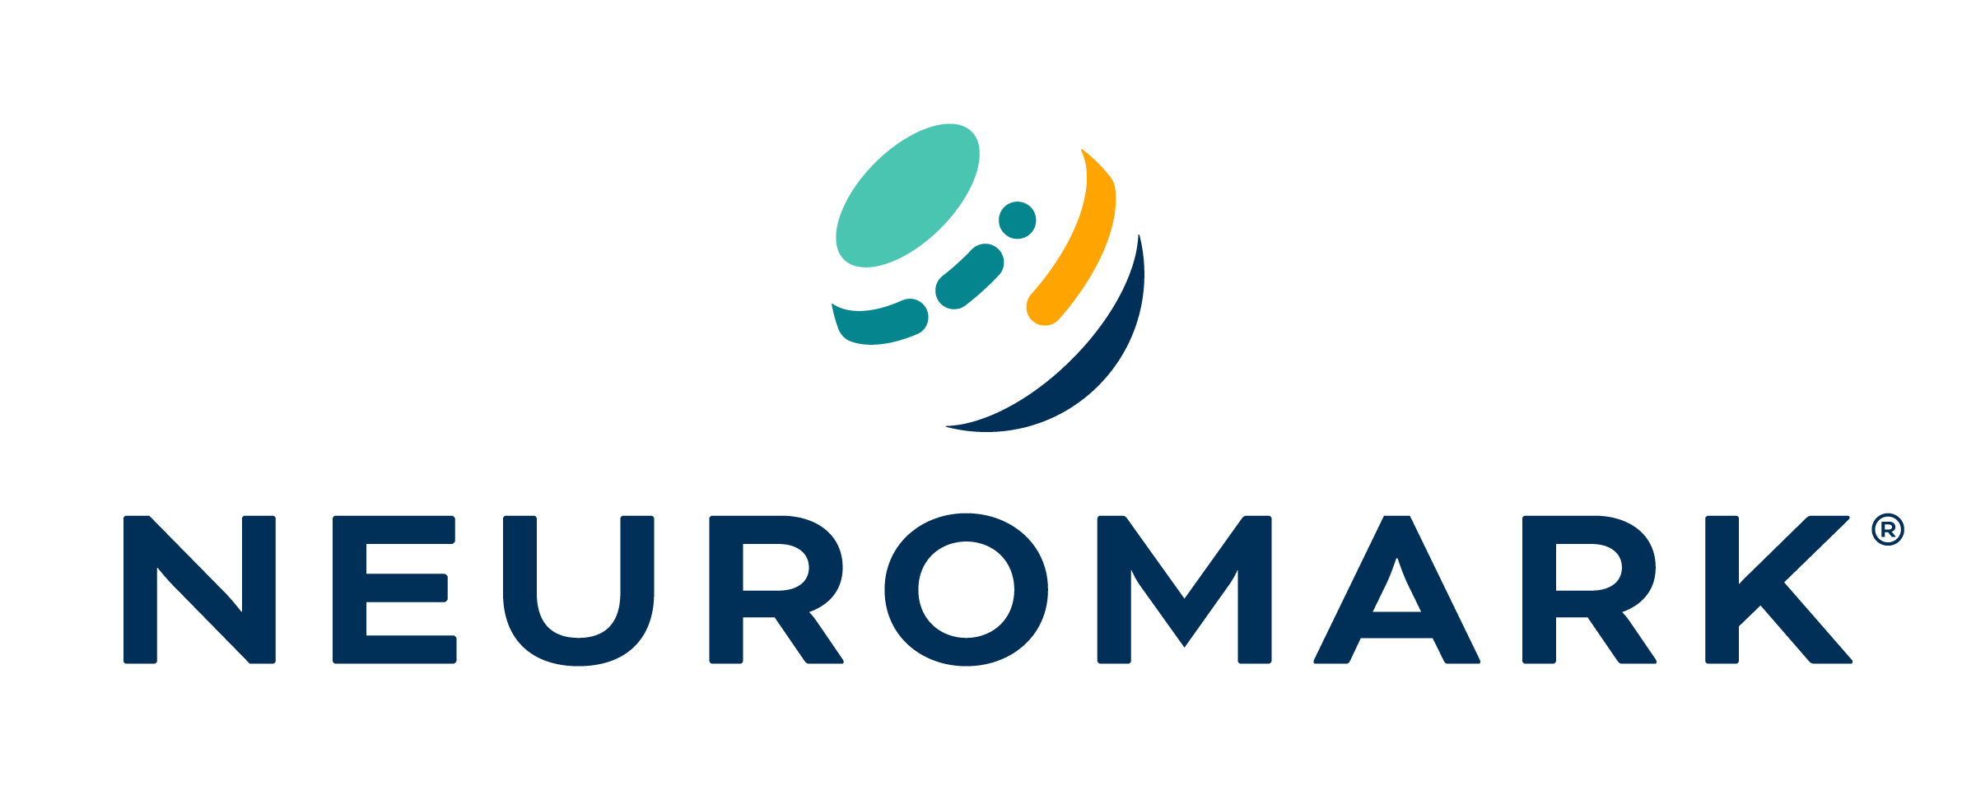
RHINITIS NEUROLYSIS THERAPY

Slide 2

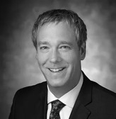
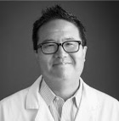
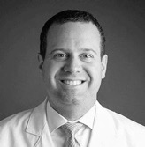
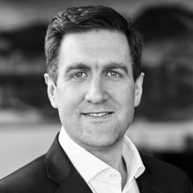
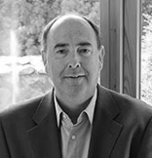
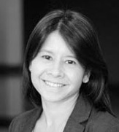
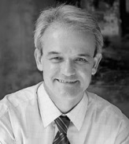
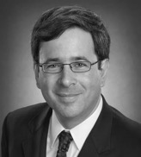


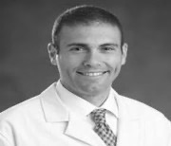
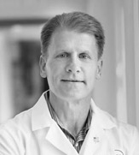
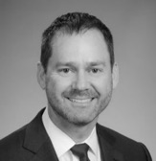
Neurent Medical – Leadership & Advisors
Leadership
Advisors
Doug Reh MD
Baltimore, MD
David Yen MD
Bethlehem, PA
Jeff Bedrosian MD
Bethlehem, PA
Brian Shields
CEO
Declan Daly
CFO
Prof Amber Luong Houston, TX
Prof PJ Wormald
Adelaide, AUS
Prof Martin Citardi
Houston, TX
Mark Fletcher
Chairman of the Board
Karen Peterson
VP Clin Reg
Marc Dubin MD
Baltimore, MD
Mike Sillers MD
Birmingham, AL
Greg Davis MD
Seattle, WA

Slide 3








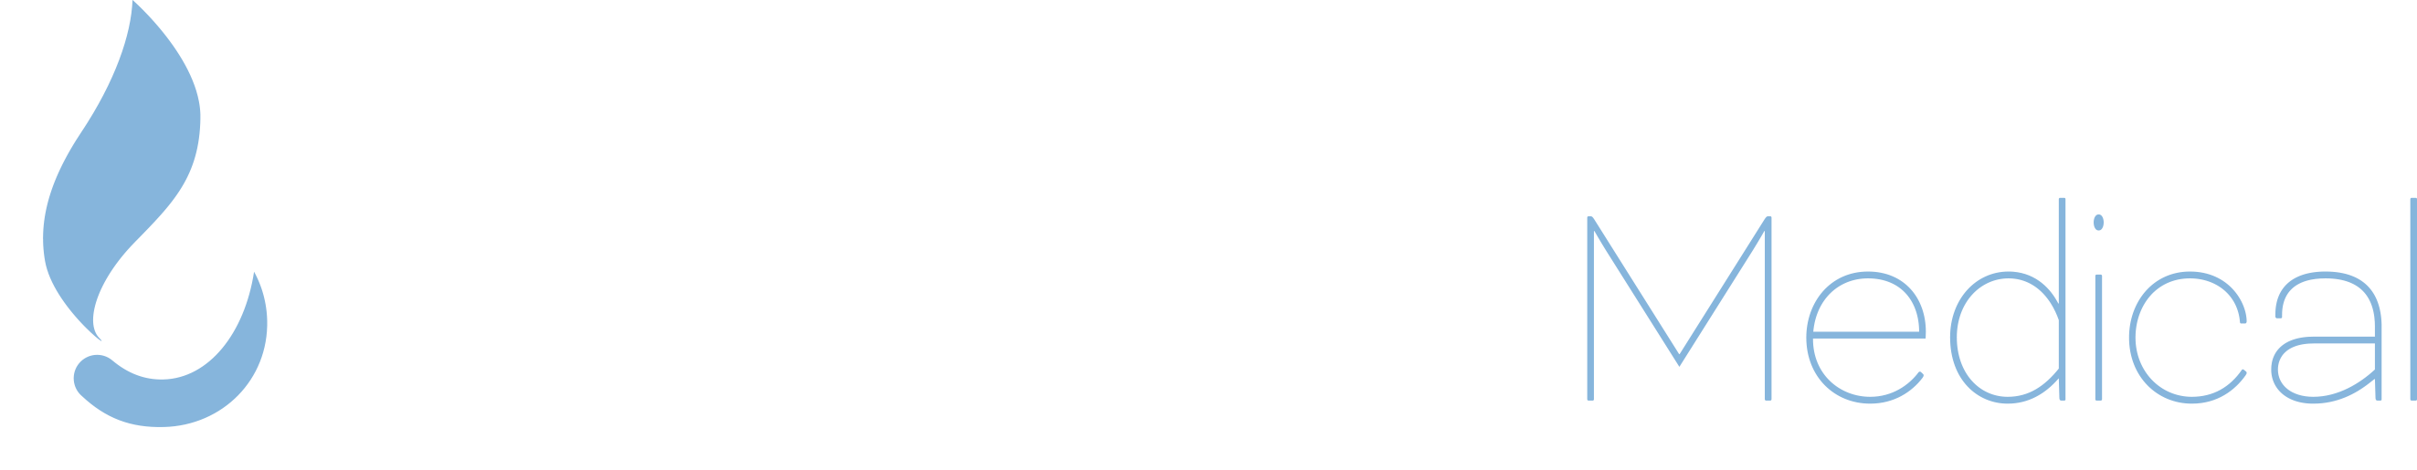
Neurent Medical – Journey
510K Clearance for NEUROMARK
CPT Code Effective Jan 1
Seed Funding
Series A
2014
2015
2017
2018
2020
2021
2023
2024
Bioinnovate Ireland
Neurent Medical LTD Formed
Series B
Neurent Medical Inc formed in the US
CLARITY Trial
Publication (Q1)
Founded by meticulously assessing over 200 unmet needs in ENT
Built with deep ENT knowledge drawn from nine successful companies
Fueled by the largest VC firms in Europe and Ireland
Guided by Board Members who have built and scaled several world class MedTech companies

Slide 4
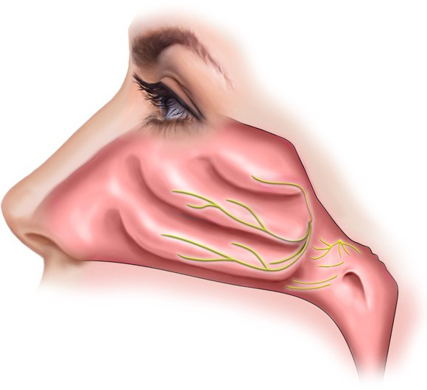
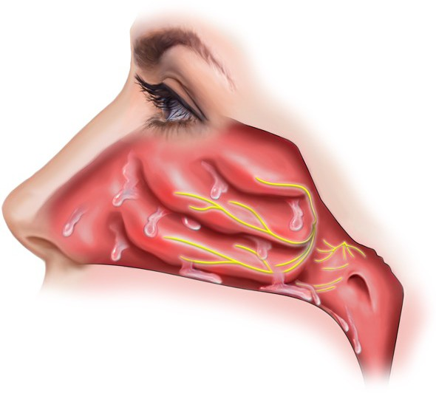
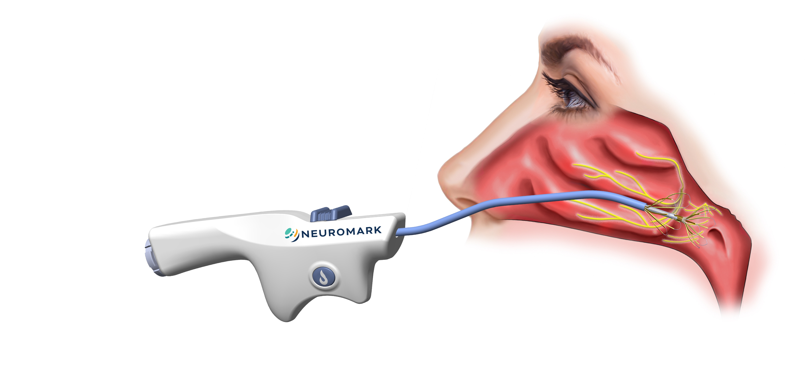
Chronic Rhinitis
Inflammation of the nasal mucosa is driven by branches of parasympathetic nerves within the nasal lateral wall.
In chronic rhinitis patients,
parasympathetic nerves become hyperactive leading to inflammation and increased mucus production.²
Chronic rhinitis is inflammation of the nasal mucosa causing symptoms such as congestion, runny nose, sneezing and postnasal drip. ¹
Disruption of the parasympathetic nerves to the lateral nasal wall has been proven to reduce both congestion and rhinorrhea in rhinitis patients.³
Wallace DV, Dykewicz MS, Bernstein DI, et al. The diagnosis and management of rhinitis: an updated practice parameter. J Allergy Clin Immunol. 2008;122 (2 Suppl): S1-84.
Satish Govindaraj, MD, et al.: Mount Sinai - Position Paper, p. 4, Feb. 2017
Tae Young Jang, MD: Long-Term Effectiveness and Safety of Endoscopic Vidian Neurectomy for the Treatment of Intractable Rhinitis Vol 3. No 4, 212-216 Dec. 2010

Slide 5
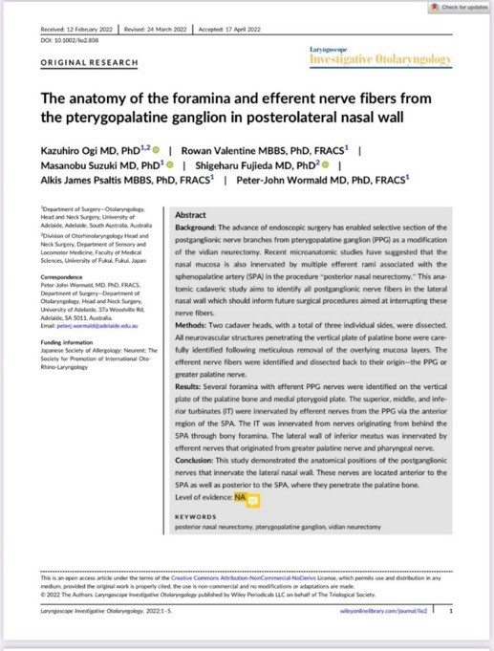
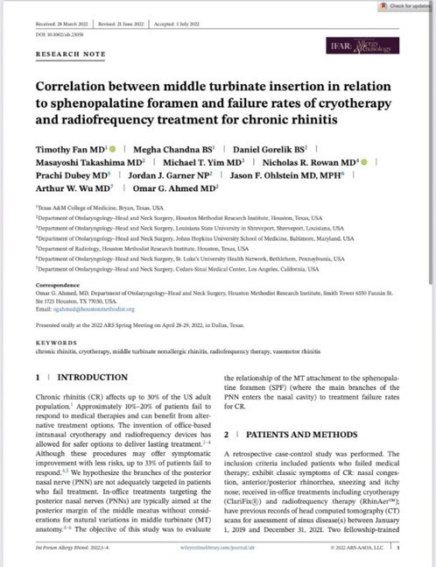
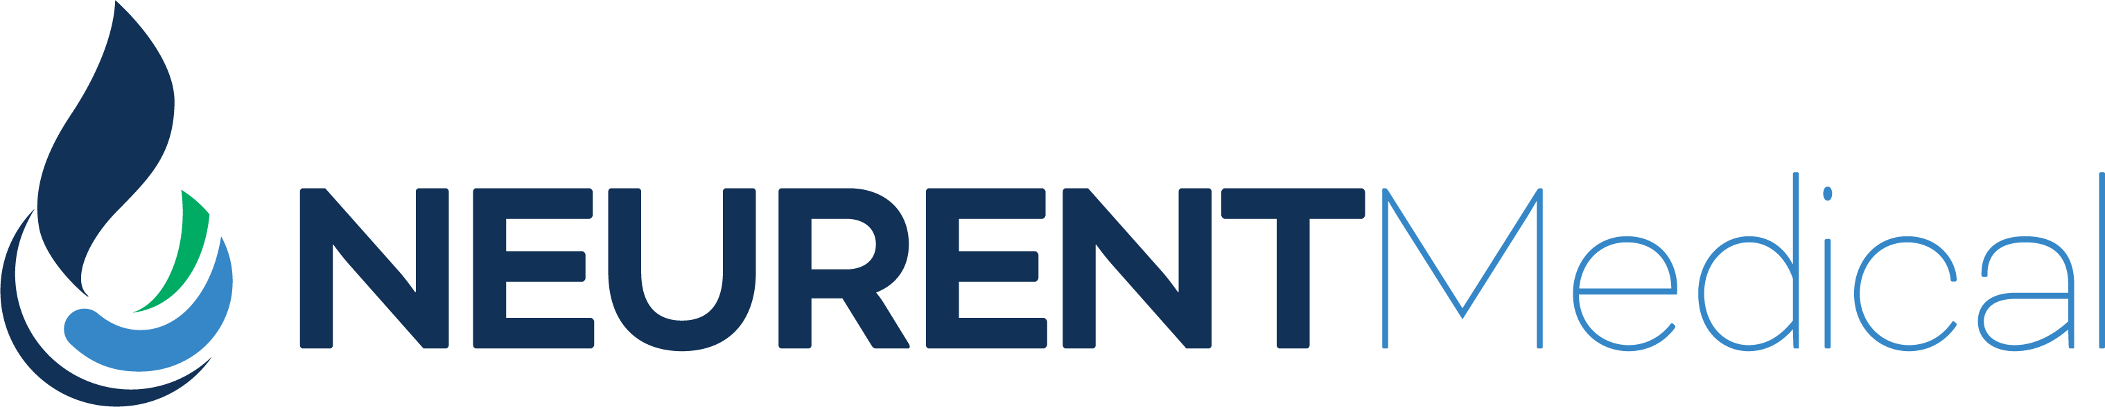
New Posterior Nasal Nerve Research
Ogi/Wormald (April 2022):
Confirms existence of extensive network of PNN along the lateral wall of the choana, posterior to the sphenopalatine foramen (SPF).
Fan/Takashima (July 2022):
67.7% of patients treated in-office for chronic rhinitis using cryo and RF had posterior lateral attachment of the middle turbinate at a location anterior to the SPF, including 90.9% of non-responders.

Slide 6

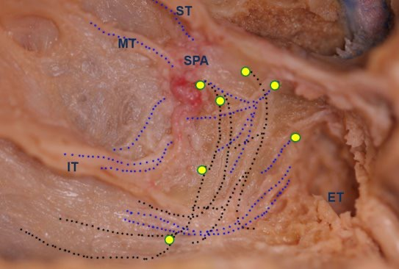
Location of Posterior Nerves
Recent Micro Neurovascular Research* reveals a high volume of Micro-foramina – including in locations posterior to the Sphenopalatine Foramen (SPF).
*Ogi K, Valentine R, Suzuki M, Fujieda S, Psaltis AJ, Wormald P-J. The anatomy of the foramina and efferent nerve fibers from the pterygopalatine ganglion in posterolateral nasal wall. Laryngoscope Investigative Otolaryngology. 2022;1-5. doi: 10.1002/lio2.808

Slide 7
NEUROMARK® Design Philosophy
NEUROMARK is designed to consistently provide easy access and wide treatment coverage including in the posterior regions of the lateral nasal wall.

Slide 8
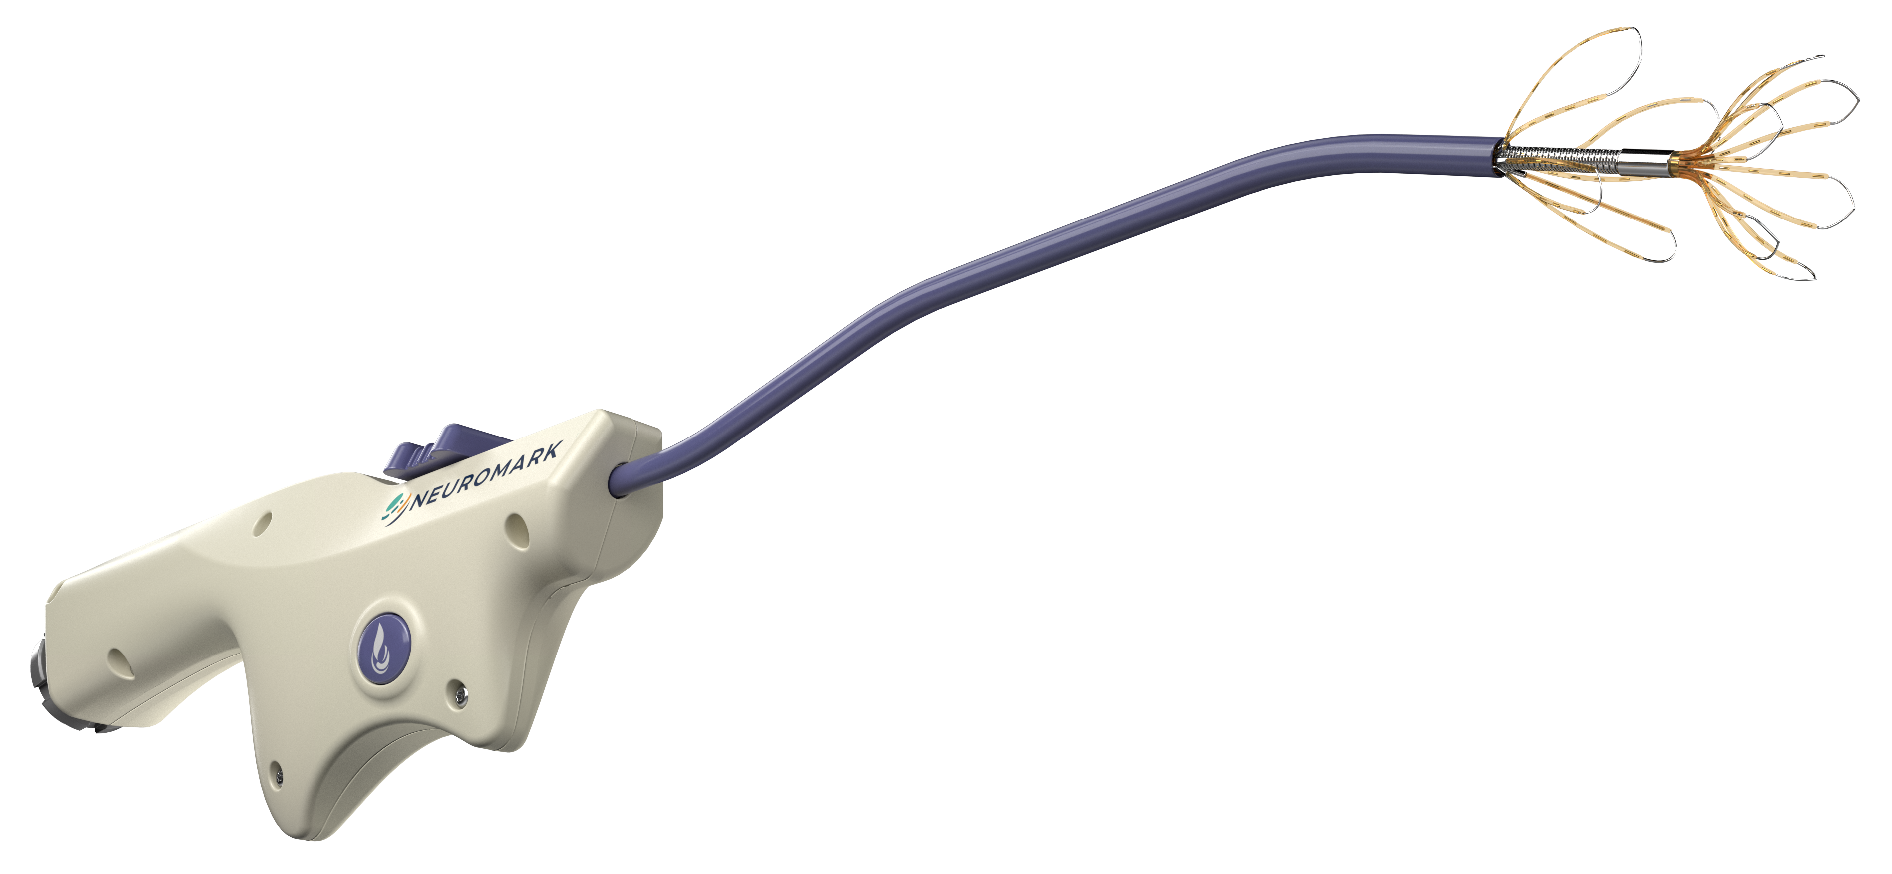
NEUROMARK® Handpiece
4.5 mm malleable shaft
Elastic leaflets
Console toggle switch
Ergonomic handle

Slide 9
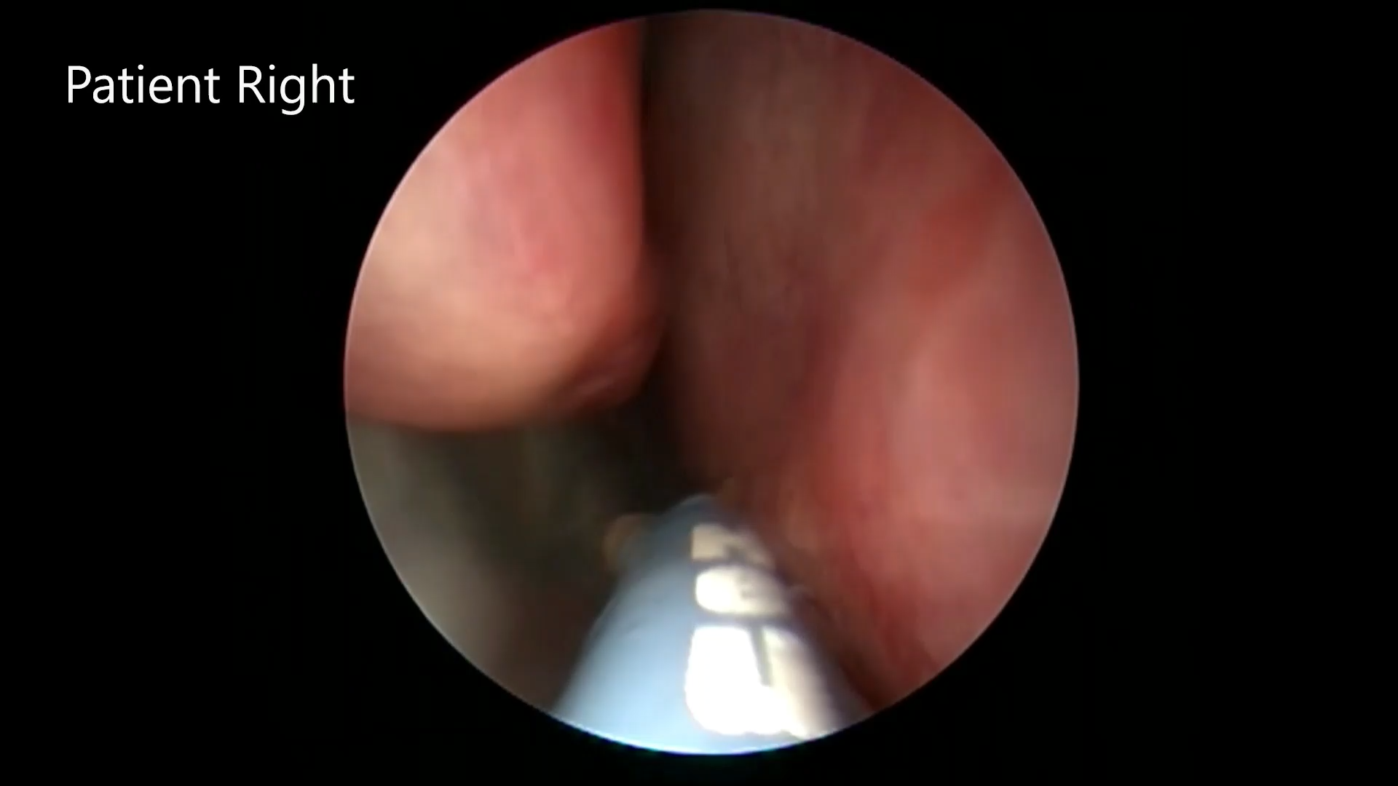
NEUROMARK® In Use

Slide 10
NEUROMARK® System Indication for Use
The NEUROMARK System is indicated for use in otorhinolaryngology (ENT) surgery for creation of radiofrequency (RF) lesions to disrupt posterior nasal nerves in patients with chronic rhinitis.

Slide 11
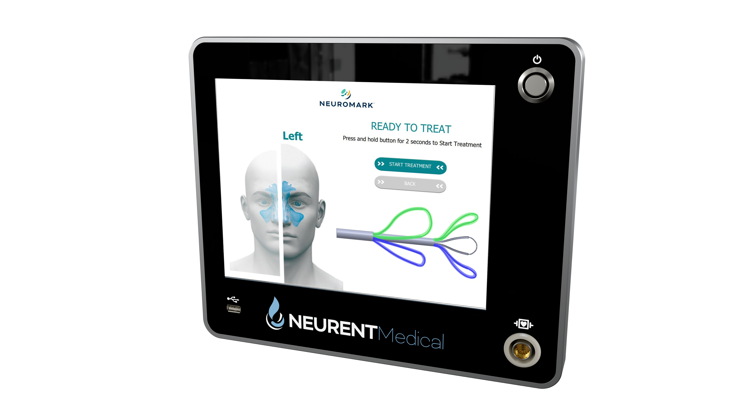

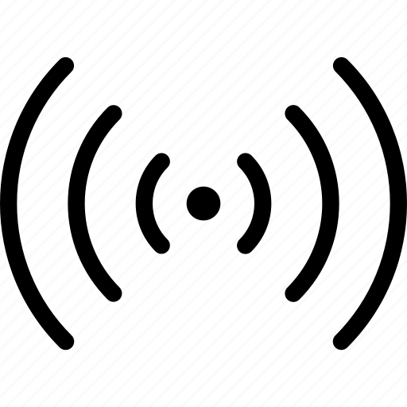
NEUROMARK® Console
User Interface Software
Confirms apposition to mucosa
Measures treatment time and impedance
Validates therapy delivery
Radio Frequency (RF) Electrosurgical Generator
Low-power 1.9W bipolar RF energy

Slide 12
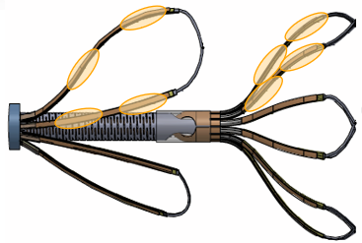
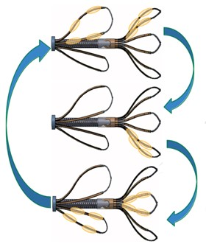
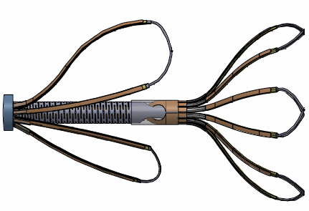
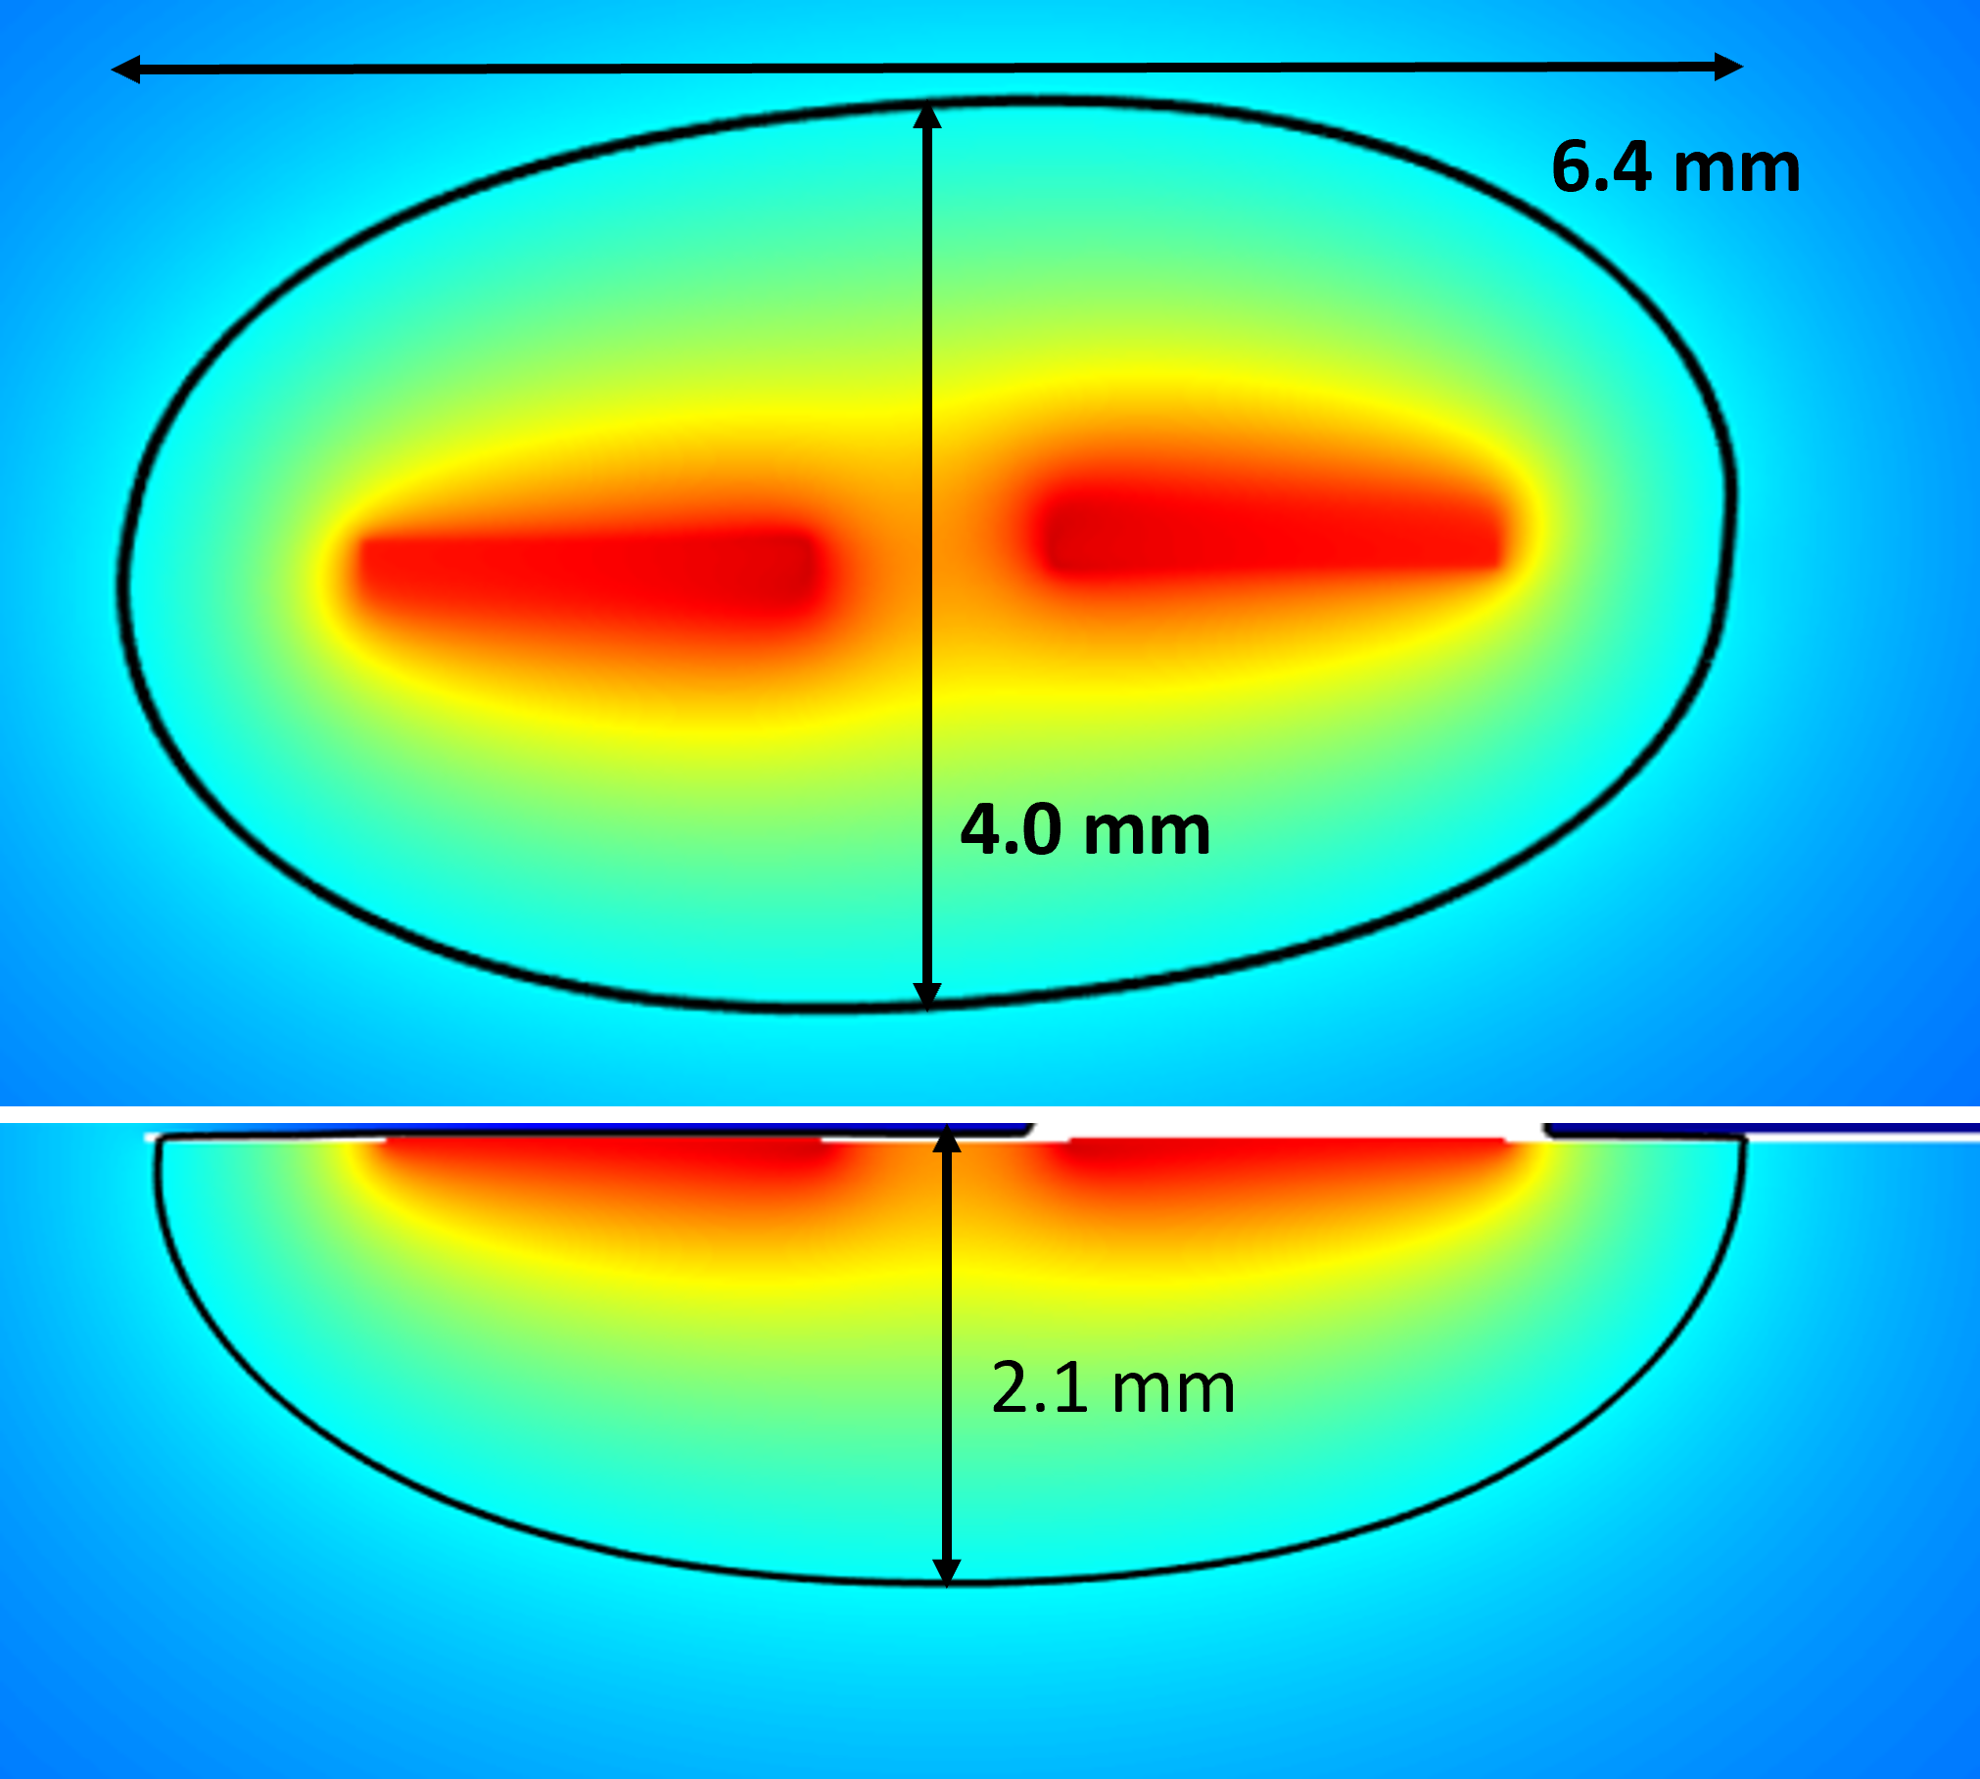
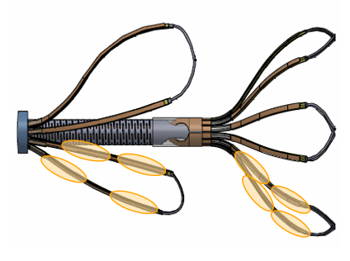
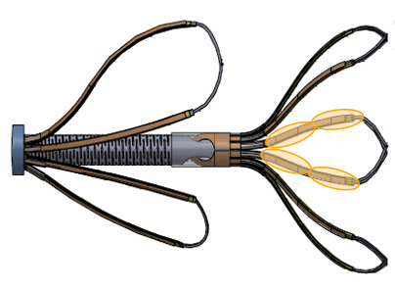
NEUROMARK® Leaflet Cycle
Targeted therapy to nerve-rich regions: more surface area, more ablations
Ablation sites create micro lesions measuring up to 6 mm L x 4 mm W x up to 2 mm D
Multiple ablation sites per leaflet treatment

Slide 13
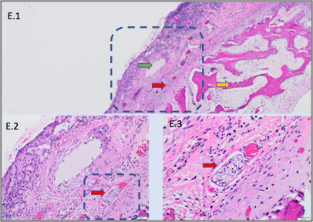
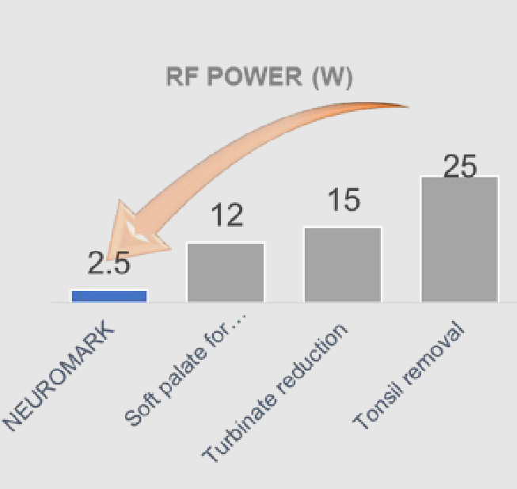
NEUROMARK® Handpiece
Micro Ablation Site
Intact Vessel
Vacuolar Degeneration
Disrupted Nerve
Impedance Controlled Very Low Power RF (ICRF) driven by smart algorithms disrupts nerve tissue, while maintaining vascular integrity ^{1,2,3}
TR-018 In vivo assessment of radiofrequency ablation for nasal tissue ablation in an in vivo porcine model-2019
Haveman et al., 2004. Effects of hyperthermia on the peripheral nervous system: a review
Hsu 2014. Significance of Clinical Treatments on Peripheral Nerve and its Effect on Nerve Regeneration

Slide 14
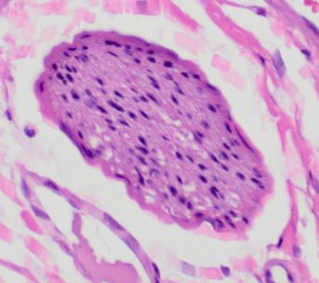
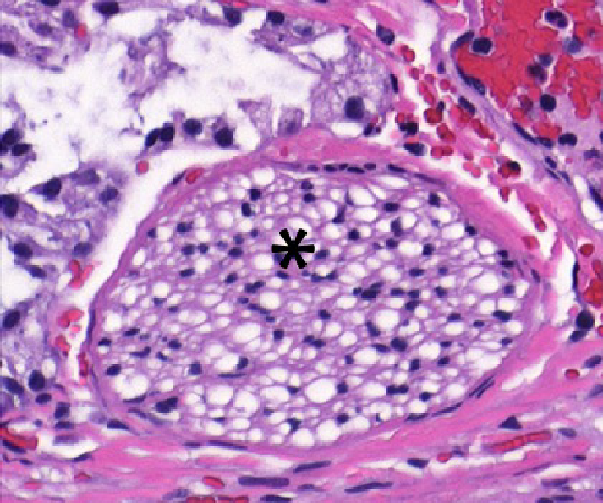
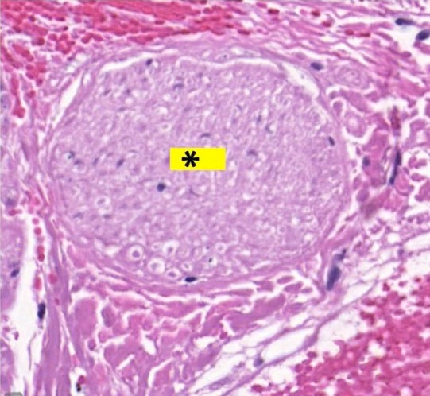
Healthy vs. Damaged Nerve Bundle
Pre-clinical evidence for impact on nerves after treatment with NEUROMARK device. ^{1,2,3}
Healthy Nerve
Axonal Vacuolar Degenerated Nerve*
Necrotic Nerve*
Stage 2 of Nerve Damage en route to Stage 4
Acute Response observed immediately after the treatment
Stage 4 of Nerve Damage
Epineurium is intact with loss of internal cellular details
Observed after 7 days of treatment
TR-018 In vivo assessment of radiofrequency ablation for nasal tissue ablation in an in vivo porcine model-2019
Haveman et al., 2004. Effects of hyperthermia on the peripheral nervous system: a review
Hsu 2014. Significance of Clinical Treatments on Peripheral Nerve and its Effect on Nerve Regeneration

Slide 15
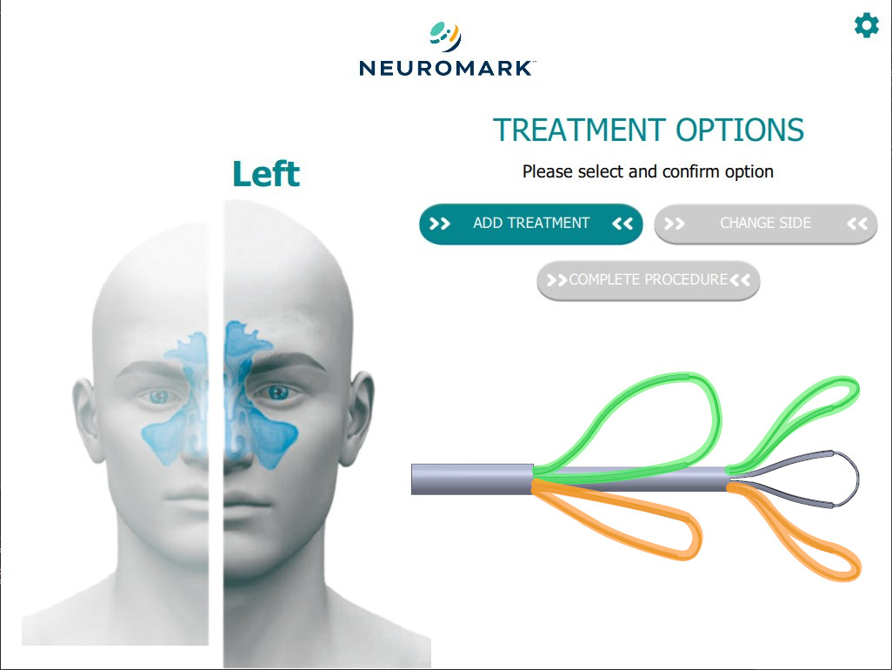
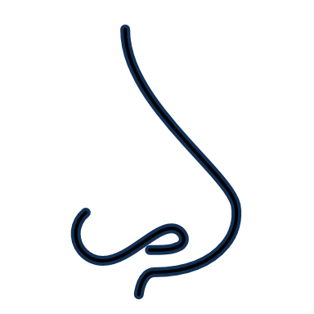
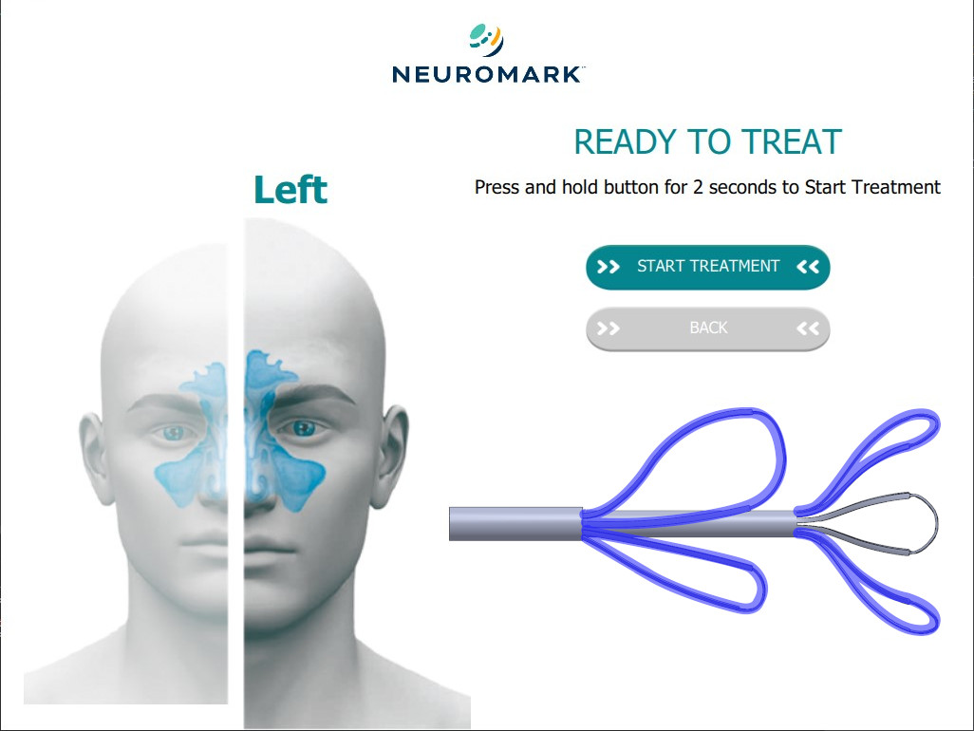
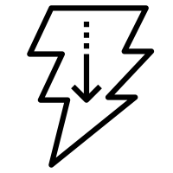
Designed for Patient Comfort
Narrow, malleable shaft is easily passed and can be shaped to easily conform to patient anatomy.
Highly elastic leaflets are designed to be atraumatic on nasal mucosa to minimize patient discomfort.
Controlled, low-energy delivery designed to minimize tissue trauma and patient discomfort.

Slide 16
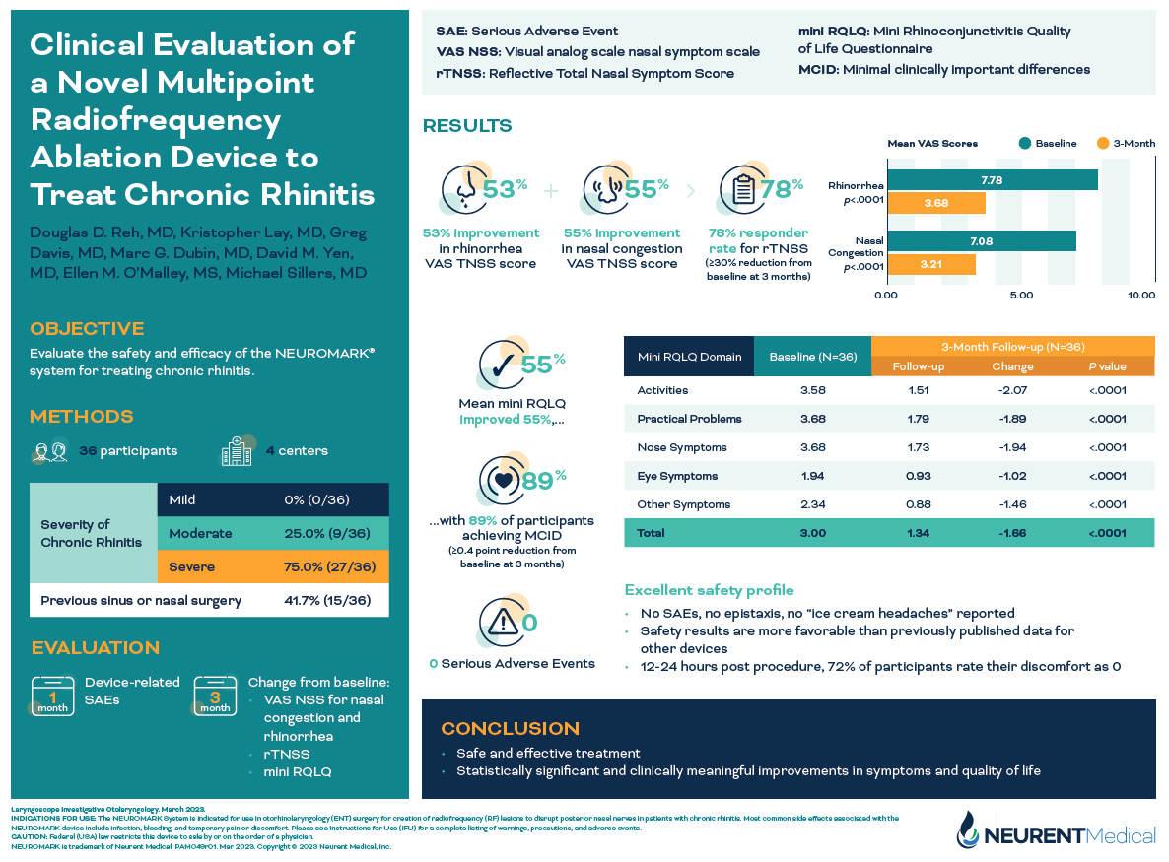

Slide 17
Experience the Difference:
Control.
Confidence.
Comfort.

Slide 18
INDICATIONS FOR USE: The NEUROMARK System is indicated for use in otorhinolaryngology (ENT) surgery for creation of radiofrequency (RF) lesions to disrupt posterior nasal nerves in patients with chronic rhinitis.
Most common side effects associated with the NEUROMARK device include infection, bleeding, and temporary pain or discomfort. Please see Instructions for Use (IFU) for a complete listing of warnings, precautions, and adverse events.
CAUTION: Federal (USA) law restricts this device to sale by or on the order of a physician.
NEUROMARK is trademark of Neurent Medical. PAM044r02 Apr 2023 Copyright © 2023 Neurent Medical, Inc.

